Slide 1
Disease of the kidney

Slide 2
Prof. Mahmood Sh.A.Karbalaie F.R.C.S.,F.I.C.S.,F.I.CM.S Consultant urologist Head of Dept. of surgery

Slide 3
learning objectives 1-identify the secretory and excretory functions of the kidney. 2-describe the normal anatomy of the kidney. 3-demonstrate the clinical application of the anatomy of the kidney. 4-classify the congenital anomalies of the kidney and the ureter. 5-describe each congenital anomaly ,presentation and management. 6-classify hydronephrosis ,describe pathology presentation diagnosis and management. 7-classify renal infection ,describe the clinical manifestations ,assess the diagnosis and decide treatment. 8-classify and describe the different types of benign and malignant tumors of the kidney. 9-discuss the clinical presentation of each entity. 10- plan for diagnosis . 11- learn staging of the different types of tumors. 12 – decide the proper line of treatment of each tumor depending on type and stage

Slide 4
The kidneys: An Excretory organ or a Regulatory organ?!!!

Slide 5
Regulate electrolytes (K, Na, etc)
Regulate pH in blood
Regulate blood pressure
Regulate blood volume (removes excess fluid)
Removing metabolic wastes
Urea, uric acid, and creatinine
This is the least important of the kidney’s functions. You can survive for a few weeks without excreting waste products in the urine, but hour by hour, the other functions are more important.

Slide 6
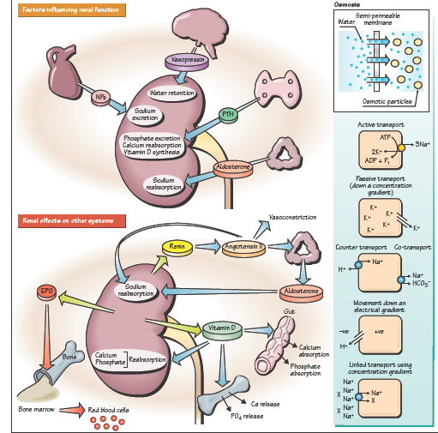

Slide 7
Anatomy

Slide 8
bean shaped, reddish brown organs.
about the size of your fist.
It measures 10-12 cm long.
covered by a tough capsule of fibrous connective tissue- renal capsule
Adhering to the surface of each kidney-two layers of fat to help cushion them.

Slide 10
The RENAL CAPSULE surrounds the kidney, made of dense fibrous connective tissue.
A layer of adipose tissue surrounds the capsule, called PARARENAL FAT (ADIPOSE). It cushions and protects.
Around that is a connective tissue layer called the RENAL FASCIA, made of loose connective tissue. It anchors the kidney to the surrounding peritoneum and abdominal wall. It is not very strong; jumping up and down can cause tearing.

Slide 11
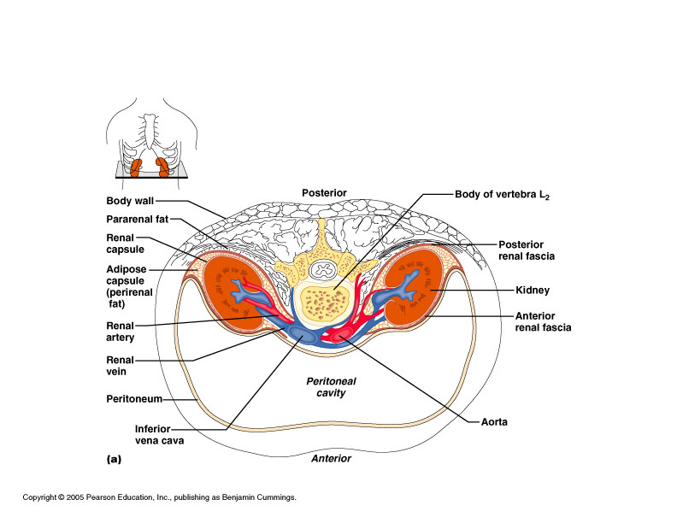

Slide 12
Renal cortex (Most superficial layer)
Renal medulla
Renal pyramids (drain into the calyx)
Renal pelvis
Calyx (drains into hylus → ureter)
Ureter

Slide 13
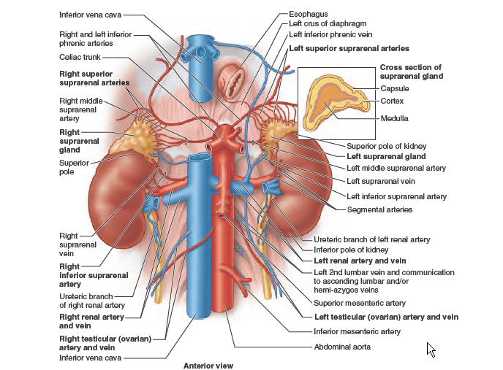

Slide 14
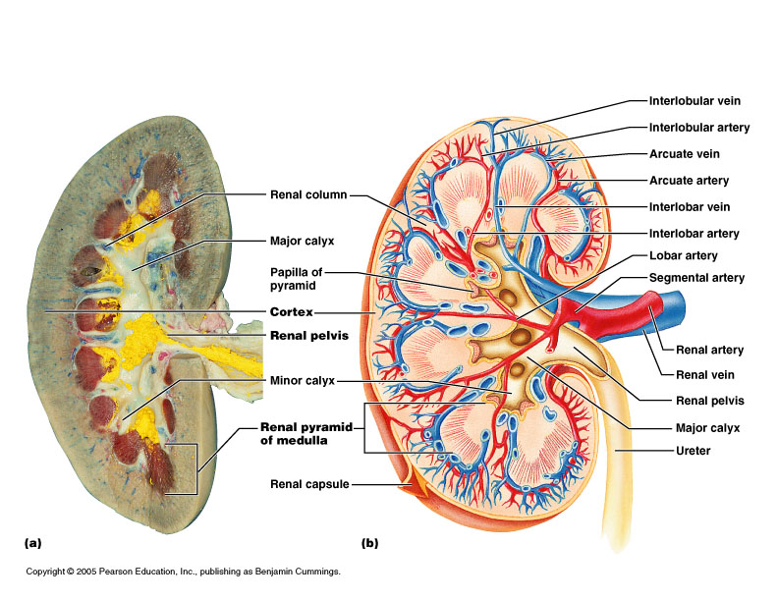

Slide 15
Congenital Renal Anomalies
Renal dysplasia
Renal hypoplasia
Renal aplasia
Ureteropelvic Junction Obstruction
Vesicoureteral reflux
Ectopic ureters
Ureteroceles
Polycystic kidney disease
Horseshoe kidney
Pelvic kidney
Aberrant vessels

Slide 16
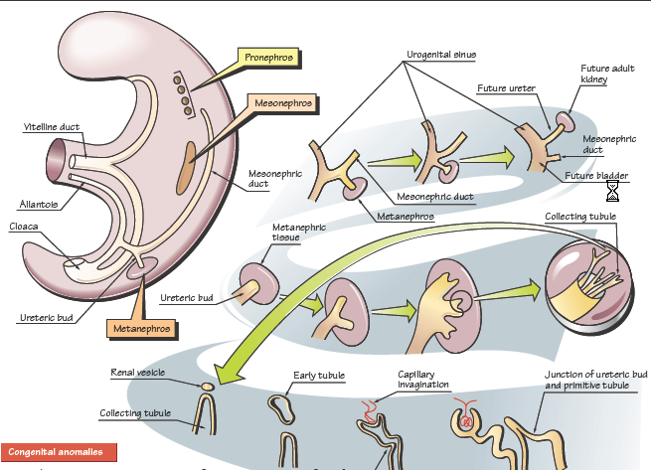

Slide 17
EMBERYOLOGY

Slide 18
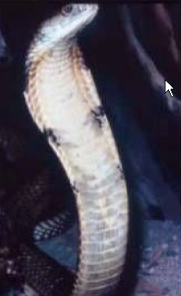

Slide 21
Horseshoe Kidney
Fusion of the lower poles of the kidneys midline
1/500 births. Seen in 7% of patients with Turner syndrome.
Wilms tumors are 4x more frequent than in general population. Other complications include obstructive uropathy, related to ureteropelvic junction obstruction, calculi and urinary tract infections.
Renal function is generally normal.

Slide 22
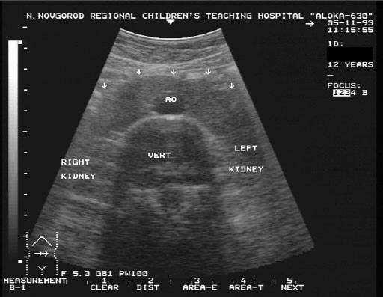

Slide 23
Congenital cystic kidney
Autosomal dominant
Abdominal mass
Haematurea
Infection
Hypertension
Uraemia
Conservative vs transplant

Slide 24
hydronephrosis
It is an aseptic dilitation of the PCS of the kidney due to back pressure by either obstruction or megaureter or reflux effect
It could be uni or bilateral

Slide 25
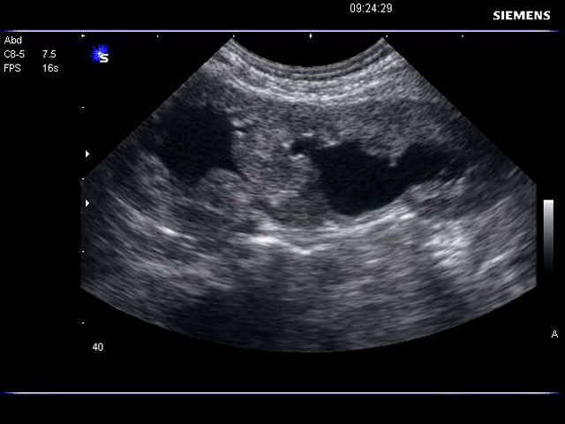

Slide 26
causes
Stone
Tumors
Inflamatory stricture
Infection TB,bilharziasis
PUJ obstruction
reflux orUretrocele
Obstruction of the ureter from outside,tumor fibrosis
For bilateral hydro,urethral stricture,BPH,meatal stenosis

Slide 27
Clinical features
asymptomatic
Pain dull or colic
Swelling of the loin
Abscess formation
Renal failure if bilateral

Slide 28
diagnosis
Urine exam
Urine C&S
Ultrasound
IVU,CT,MRI
Radioisotop scan DTPA ,DMSA,MAG3
Endoscopy
Pressure test

Slide 29
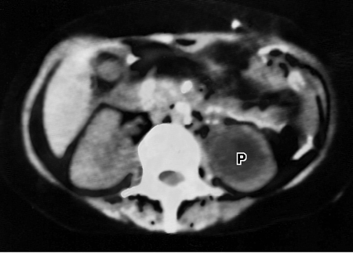

Slide 30
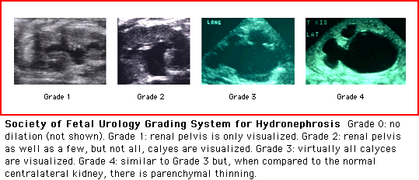

Slide 31
Vesicoureteric reflux
An etiology in 9% of individuals with hydronephrosis. Predisposes individuals to chronic renal failure.
Best evaluated by voiding cysturethrogram (VCUG).
Grade I- Ureter only
Grade II - Ureter, renal pelvis, calyces without dilatation
Grade III - Dilatation or tortuosity of ureter and/or dilated pelvis
Grade IV - Shape of calyces maintained but dilated
Grade V - Gross dilation of collecting system
Management may include prophylactic antibiotics or surgical intervention

Slide 32
treatment
Pyloplasty
Reimplantation
Prostatectomy
Urethrotomy
Catheter drainage JJ cath,nephrostomy,urethral cath

Slide 33
Kidney infection
bacteria reach the kidney either from the blood or from the lower part of the urinary system
Common organisms include E.coli,Gram negativeor Proteus
More in females
Progress to septicaemia
Acute pyelonephritis,common type of kidney infection

Slide 34
Clinicaly
Fever
Pain
Headache
Nausea
Urgency
Frequency
Dysurea
uraemia

Slide 35
Midstream urine sample
Culture and senstivity
Ultrasound
Renal function test
Blood culture
Cystoscope
Contrast study

Slide 36
treatment
According to C and S antibiotic is given eg.amoxicillin and gentamycin
Treat the cause

Slide 37
chronic pyelonephritis
Interstial inflamation and scaring
Pyonephrosis is a hydronephrosed infected kidney
Renal carbuncle abscess formation in the kidney parenchyma
Perinephric abscess

Slide 38
Renal neoplasm
Benign tumors
Adenoma
Angioma
angiomyolipoma

Slide 39
Malignant tumors
Wilms tumor
Age below five
Lower pole
Unilateral
The child present with renal mass,hypertension,haematurea and loin pain

Slide 40
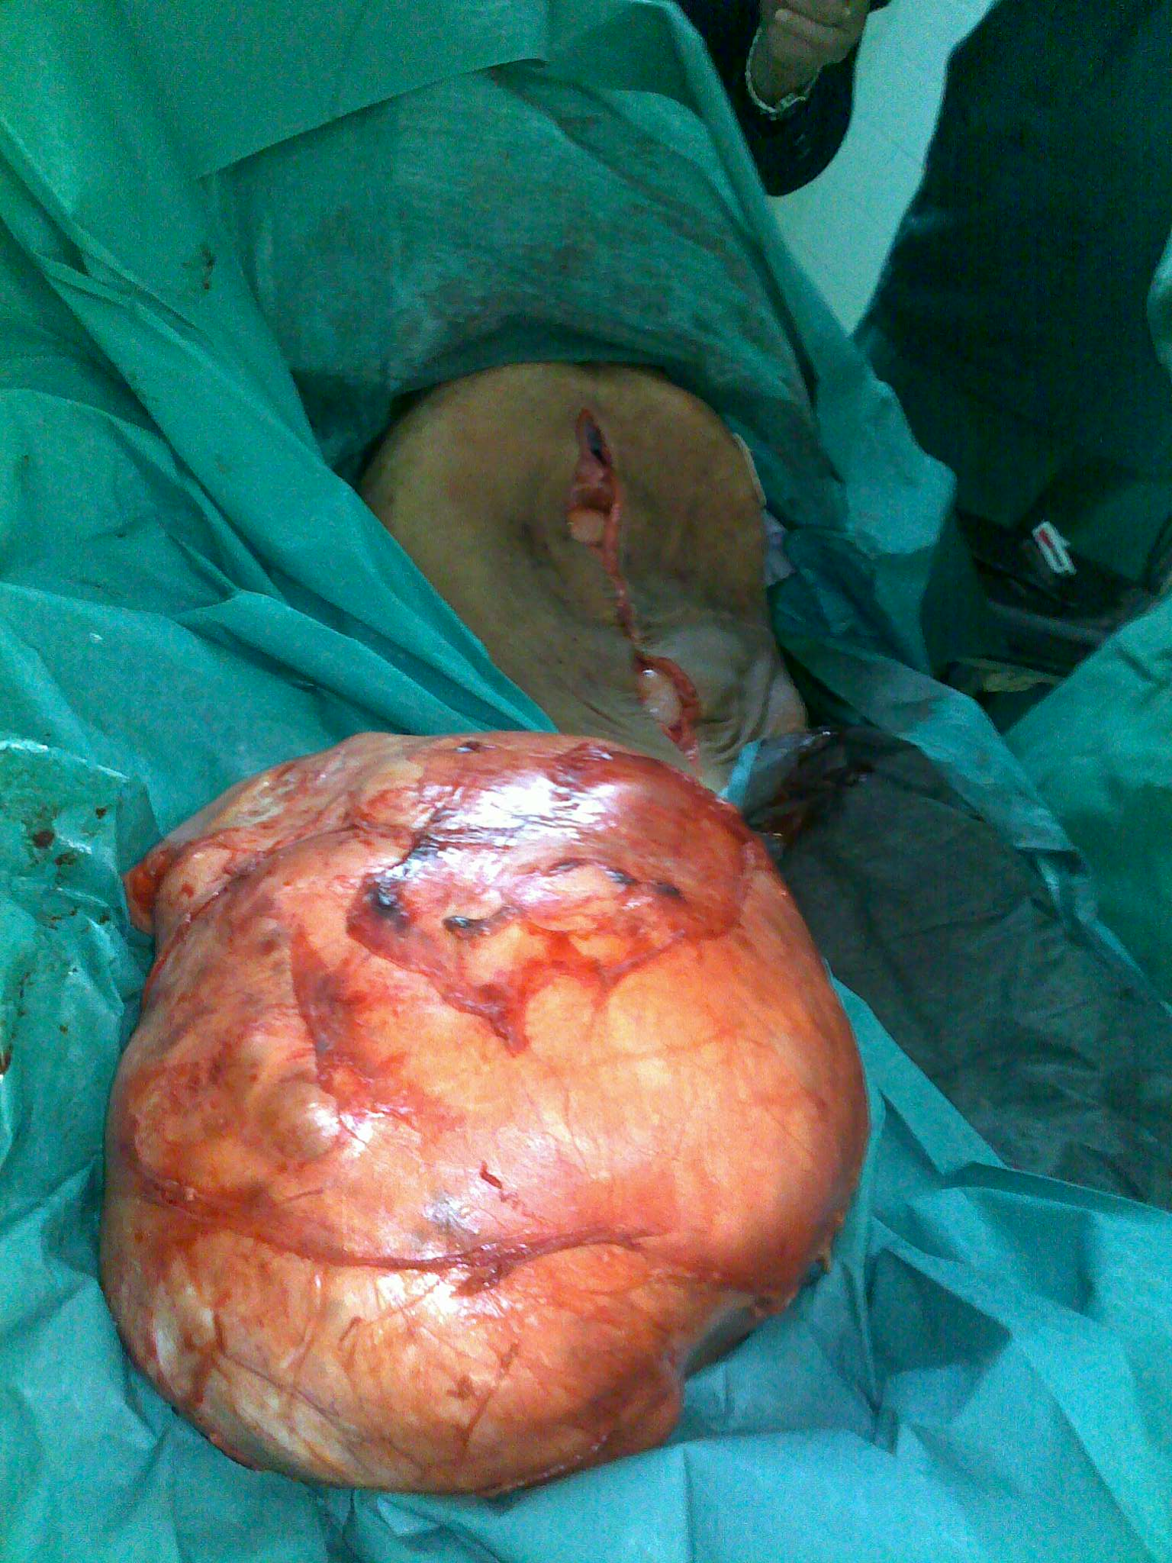

Slide 41
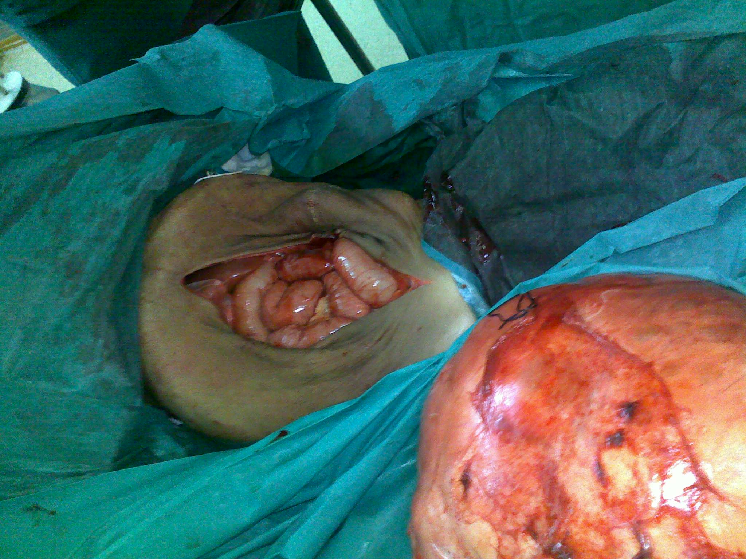

Slide 42
diagnosis
Ultrasound
CT , MRI
TREATMENT
Chemotherapy with surgery

Slide 43
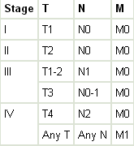

Slide 44
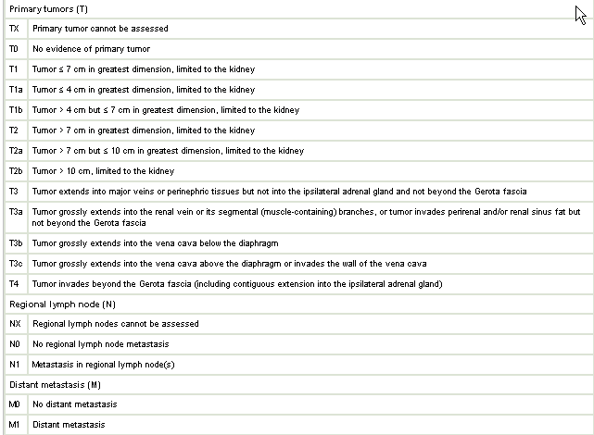

Slide 45
hypernephroma
Adenocarcinoma
75%
Usually unilateral,manly upper pole
More in men
Presentation,haematurea,mass pain,rapid forming varicocele.
Asymptomatic
Metastesis
Fever,polycythemia

Slide 46
investigation
CBP
Renal function test
Ultrasound
IVU,CT scan
Treatment
Radical nephrectomy

